Slide 1
History of NACAA
1914 PA County Agents

Slide 2
Purpose of the Organization Edwin Bay, 35 years, Sangamon Ill
From it’s origins – Professional Improvement First!
Exchange Ideas and Methods
Establish and maintain high standards of agents
Promote opportunities for additional training
Increase potential for leadership and advancement
Encourage high levels of accomplishment
Encourage evaluation systems
Hold high the banner of County Agents and Cooperative Extension work

Slide 3
History of Extension
1851 – Illinois Farmer’s meeting
Resolution – Common Man’s Educational Bill of Right
Establish a university in IL for all industrial classes
1853 – Jonathan Baldwin Turner
Proposed land grant college in each state
1855 – Michigan – 1st Ag College in USA, Lansing
1857 – Congressman Justin Morrill, VT
Colleges of Ag and Mechanical Arts proposed
Vetoed by President James Buchanan

Slide 4
Limestone Burning

Slide 5
History of Extension
1862 – Morrill Act signed by President Abe Lincoln
Land Grant College Act
Grants of 30,000 acres of public land for establishment of colleges to teach Ag and Mechanical Arts
Iowa first to apply
Connecticut first state to qualify (1863)
1875 – First report of Farmer Institutes
Prior to Extension, at land grant colleges
1887 – Establishment of Experiment Stations

Slide 6
1911 Farmers Institute, Penn State

Slide 7
History of Extension
1894 – First mention of the word – “Extension”
In Proceedings of the Land Grant College Association
“The Attitude of the College toward University Extension”
Noted 6 lectures on crops, soils, feeding plants and animals
1900 – Cornell, NY – created Department of Extension
1901 - Illinois – Noted Extension staff in college
Education carried out thru Farmer Institutes
Included topics related to Homemaking

Slide 9
History of Extension
1902 – Seaman Knapp, USDA develops demonstration farms in the south
“What a man hears, he may doubt. What he sees he may possibly doubt. What he does himself, he can not doubt”
1903 Porter Community Demonstration Farm, Terrell, TX
Boll Weevil eradication
“Special Agents” to spread information
24 hired within 1 year

Slide 10
History of Extension
1903/04 Iowa, Professor Perry G. Holden
Better Seed Corn selection demonstrations
Educational Train – 600 stops in Iowa towns to see seed corn exhibits
1906 Smith County TX provided county funds toward salary of WC Stallings, First County Agent???
By 1908 reported 157 agents in 11 Southern States and first note of Boys and Girls Clubs

Slide 11
Champion Boy Corn Grower

Slide 12
1910 – AB Ross hired in Bedford PA
1911 – John Barron starts in Broome Co., NY
Farm Bureau local sponsoring agency
1911 – 4 Leaf Clover adopted by 4-H clubs
1912 – Sears/Roebuck Foundation offers $1,000 to a county to employ county agents
$60,000 donated

Slide 13
1916 Butler County, PA Field Day

Slide 14
History of Extension
By 1912 farmers are demanding technically trained people for advisory and educational capacity
1914 Smith (GA)-Lever (SC) Act
Purpose – Rural Education
Foundation of hiring county agricultural advisors
Trinity of College, Experiment Station and Extension
Can you imagine what agriculture was like 100 years ago?
Appreciate the progress that has been made!

Slide 15
1918 PA Family Living Agents

Slide 16
NACAA – The Early Years
Recognition that each state had special needs
Concern that some states were lowering standards in order to meet increasing demand for County Agents
No higher institute education
Limited practical knowledge or experience
Early leaders discussed need of own organization to maintain high standards and ethics

Slide 17
1918 PA County Agents

Slide 18
NACAA – The Early Years
First Association on Record – IL, 1913
1914 Bill Eckhart, DeKalb, IL suggests group of agents from several mid-west states meet during International Livestock Expo in Chicago
Discuss common problems
Potential for a national association
25 in attendance
Agreed to meet the following year

Slide 19
1919 Barn Meeting

Slide 20
NACAA – The Early Years
1916 – 70 men in attendance in Chicago
Recognized as the first Annual Meeting of NACAA
Adopted constitution and bylaws
Purpose noted – a means to exchange constructive ideas in county agent work and establish high standards regarding qualifications and ability of men
Notes mention dislike of rules and USDA red tape
Ed Heaton elected first president

Slide 21
NACAA – The Early Years
1920 –
First recorded records
First committee report – Professional Improvement
First Annual Banquet
Dues - $.50 increased to $1.00
Minimum $10.00 dues per state association
1921
2 day annual meeting
18 states represented

Slide 22
Using Dynamite to Open Ditches

Slide 23
NACAA – The Early Years
1931
43 states with 1992 County Agents surveyed by USDA
171 – no college training or degree of any kind
329 – some college work
1453 – Bachelors Degrees
79 – Masters Degrees
Average tenure – 4.9 years, only 21 with 15 years or more
25% remained in county less than 1 year
Low salaries identified as reason
49% $2 – $3,0000; 40% $3 - $4,000; 6% $4 - $5,000

Slide 24
1921 Auto Farm Tour

Slide 25
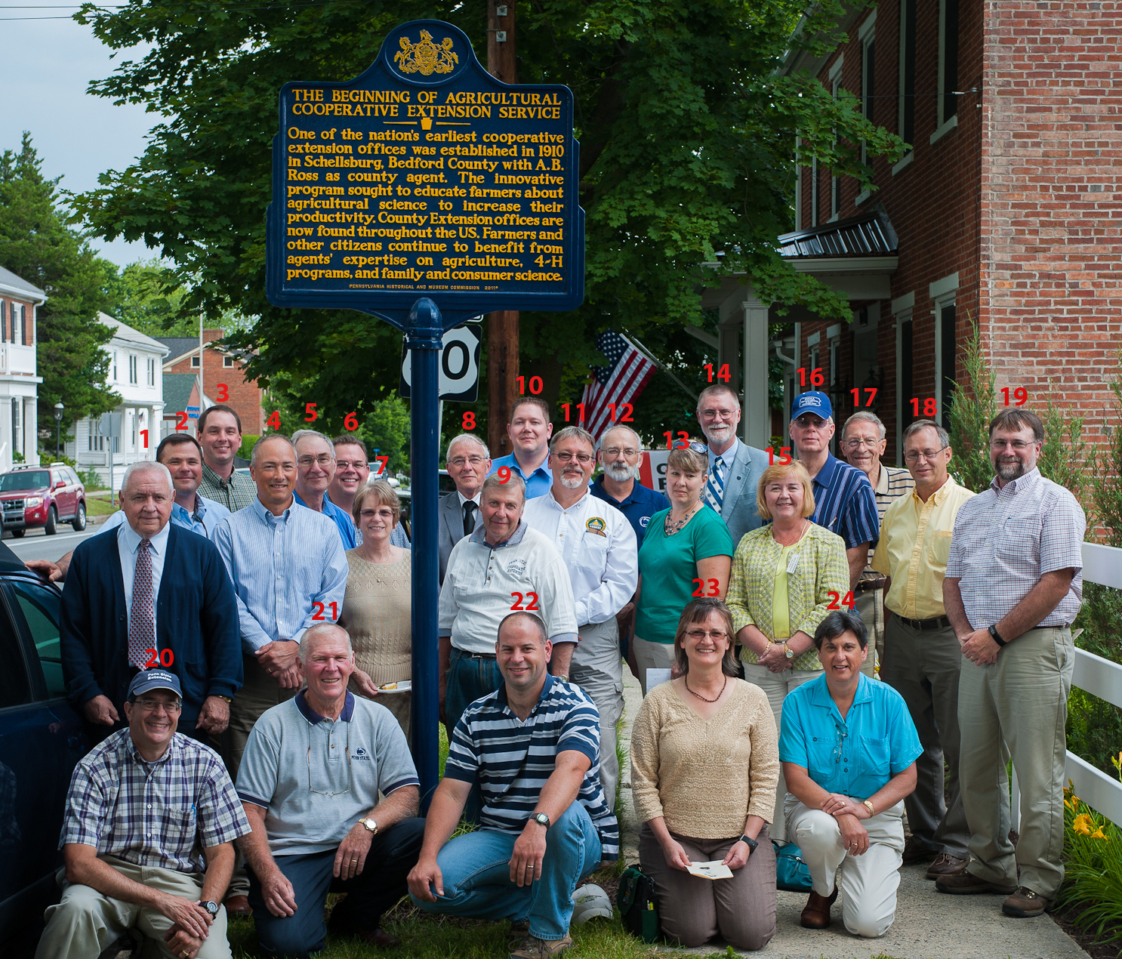
NACAA – Celebrating 100 Years

